Slide 1
Week 4 Classroom Session

Slide 2
Introduction to JavaScript
JavaScript is a interpreted scripting language which supports cross-platform and is lightweight in nature.
JavaScript is used on both client side(in the browsers) and server side to handle requests at backend(node js).
JavaScript enables client to interact with web pages dynamically and do some logic operations on each event they trigger.

Slide 3
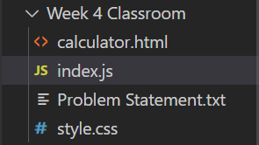

How to create a JS file
Create a file with the filename(index) and with the extension as .js
Place your javascript code inside the file.
Example:

Slide 4
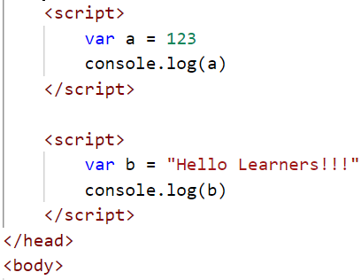
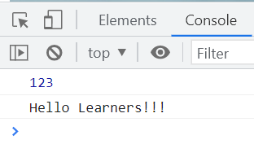
Ways to execute Javascript
We have two ways to execute javascript.
create a .js file and run it with terminal
write your javascript code in script tag in html file as shown below
we can write script tag anywhere in the html page.
we can also write any number of scripts we want in the html page.
The order of the script tag execution will happen as written in the html page on first come first serve basis.

Slide 5

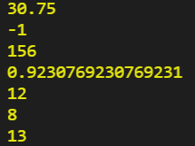
Arithmetic and Logical Operations
var x=12,y=13;
console.log(10.5 + 20.25); // 30.75
console.log(x - y); // -1
console.log(x * y); // 156
console.log(x / y); // 0.9230769230..
console.log(x % y);// 12
console.log(2**3); // 8
console.log(++x); // 13
var first=true,second=false;
console.log(first && second)
console.log(first || second )
console.log(!first)
console.log(!second)

Slide 6

Branching (If else..) in JS
Branching is nothing but if else conditions
JavaScript supports as many if,or if else statements just like java.
Example:
var first=true,second=false;
if(first==true){
console.log("First variable is true")
console.log("Semicolon is not necessary JavaScript")
}

Slide 7

Looping in JS
Loops are useful when we want to run a piece of code over and over again, and in each iteration print or use a different value in logic.
There are three basic versions of loops. (for,while,do-while)
Example:
var i=0;
while(i<10)
{
console.log(i);
i++;
}
for(var i=0;i<10;i++)
{
console.log(i);
}

Slide 8
Switch Case in JS
Switch Statement is also used to create branches and used to perform different actions based on different given conditions.
If none of the switch cases is matched with the condition then ,the default case code block is executed.
var name='uk';
switch(name){
case 'uk':
console.log('uk');
break;
default:
console.log("Default case")
}

Slide 9
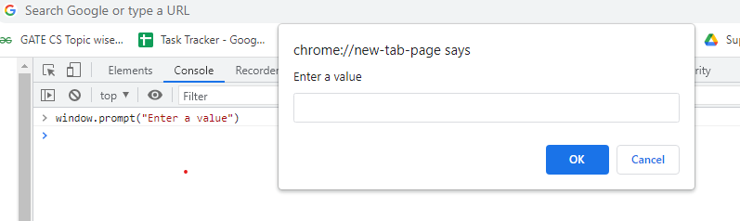
Take user input
Window.prompt() method is used to take input from user.
It works only in browser. will not work in .js files.
promt(“Enter a value”) also take as parameter called message of type String which will be displayed while taking input from user.
The value returned by prompt() method is always of type ‘String’.
We can convert that value to int using Number.parseInt(window.promt()) syntax.

Slide 10
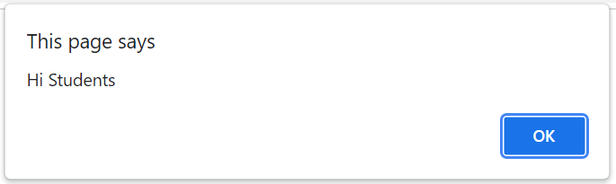
Display message in page
We can let browser display Pop up messages in the web page.
We use alert(“message here”)
This works only in the browser console.
Example:
alert(“Hi Students”)
The above code will show a message “Hi Students” in the web page as shown below.

Slide 11
Problem Statement 1
Use javascript and create
Diamond pattern
Enter the first half number of rows ‘n’ to get the output as 2n-1 rows diamond pattern.
Sand Glass pattern
enter the number of rows needed in first half of the sand pattern.
Armstrong number
Write the code needed to check if the given number is armstrong number.
Example: 153
length of the number is 3
1³ + 5³ + 3³ = 153
Hence number is Armstrong number

Slide 12
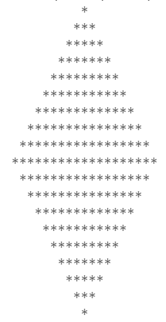
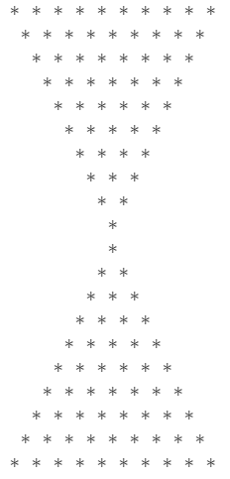
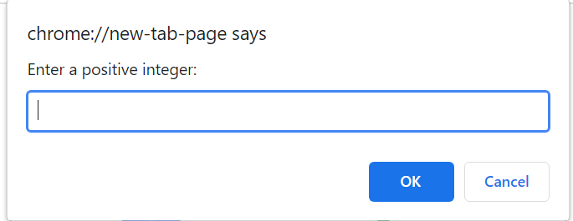
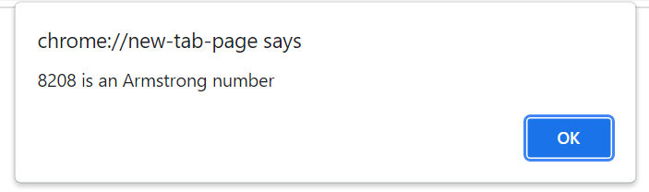
Sample Output
Diamond Pattern
Sand glass Pattern
Armstrong number

Slide 13
Problem Statement 2
Create a Banking page with the below options.
1. Deposit
2. Withdraw
3. Transfer
0. Logout
When options 1/2 are selected, take amount from the user. When 3 is selected, take bank number and amount to be transferred from the user and when 0 is selected, terminate the loop.
If any other number is entered other than 0/1/2/3, print “enter a valid option” in console and take input again.
Keep repeating the loop till 0 is entered.
Make sure that the minimum balance is Rs 1000/-
After taking the inputs from user, do the necessary calculations and print the final bank balance.

Slide 14
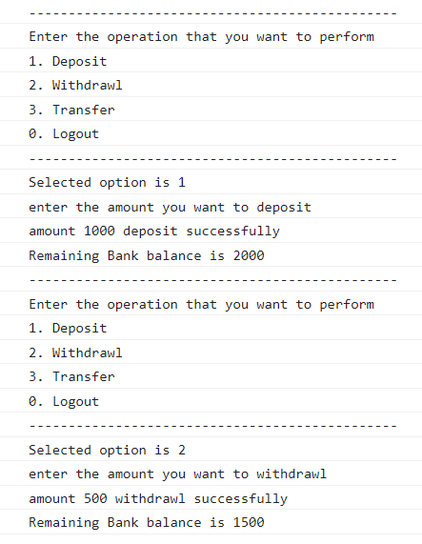
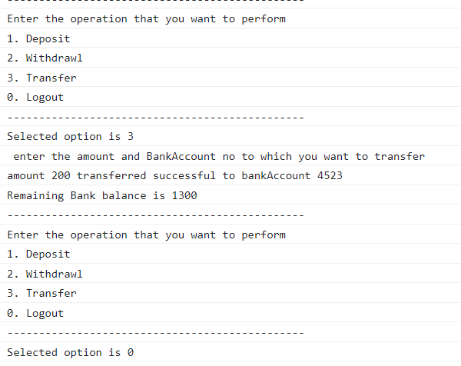
Sample Output

Slide 15
Problem Statement 3
Use the week 2 classroom sign up problem and perform password verification.
In Sign Up page check if the password and re-enter password matches or not. If doesn’t match, show an alert message.
when username and password are registered and are correct, allow the user to see home page.
Make sure all the form validations work. Only after the form is validated, invoke the function to check password.

Slide 16
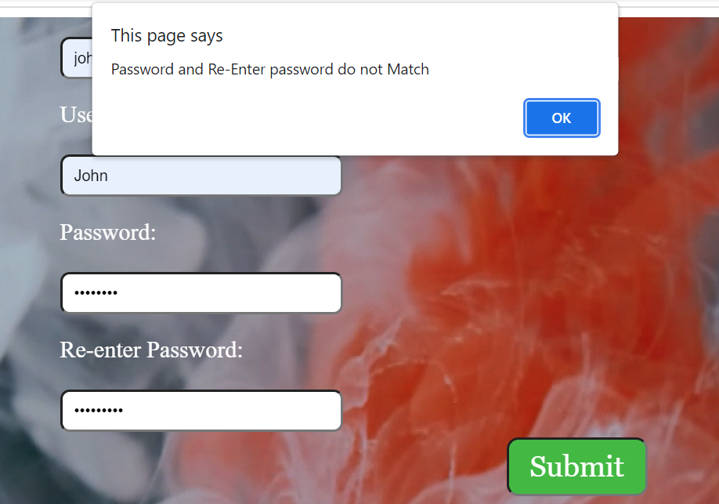
Sample Output

Slide 17
Thank You

